Slide 1
CSCI2100C Lab 1
Prepared by:
Lo Chun Hei
(office @ ERB615)

Slide 2
Welcome to CSCI2100C!
Tutorial slides are uploaded to Blackboard 1 day before each tutorial.
Remember to enroll in Piazza for discussion and questions!
4 individual programming labs (4% each)

Slide 3
Agenda
Online Judge Platform
Recommended IDEs
C language
Overview of Lab 1 Problems

Slide 4
Agenda
Online Judge Platform
Recommended IDEs
C language
Overview of Lab 1 Problems

Slide 5
Online Judge Platform (OJ) Introduction
Website: https://oj.boleyn.su/
All 4 labs will be delivered via the OJ, i.e. the OJ handles
Posting of problems and their description
Submission of your codes
Judgement of correctness
You will get full mark on the problem only if your code passes all testcases (accepted);
0 marks are given otherwise.
Extra practice questions available apart from those in the 4 labs
If you have your laptop now, you may follow this hands-on guide on the OJ as we walk through it

Slide 6
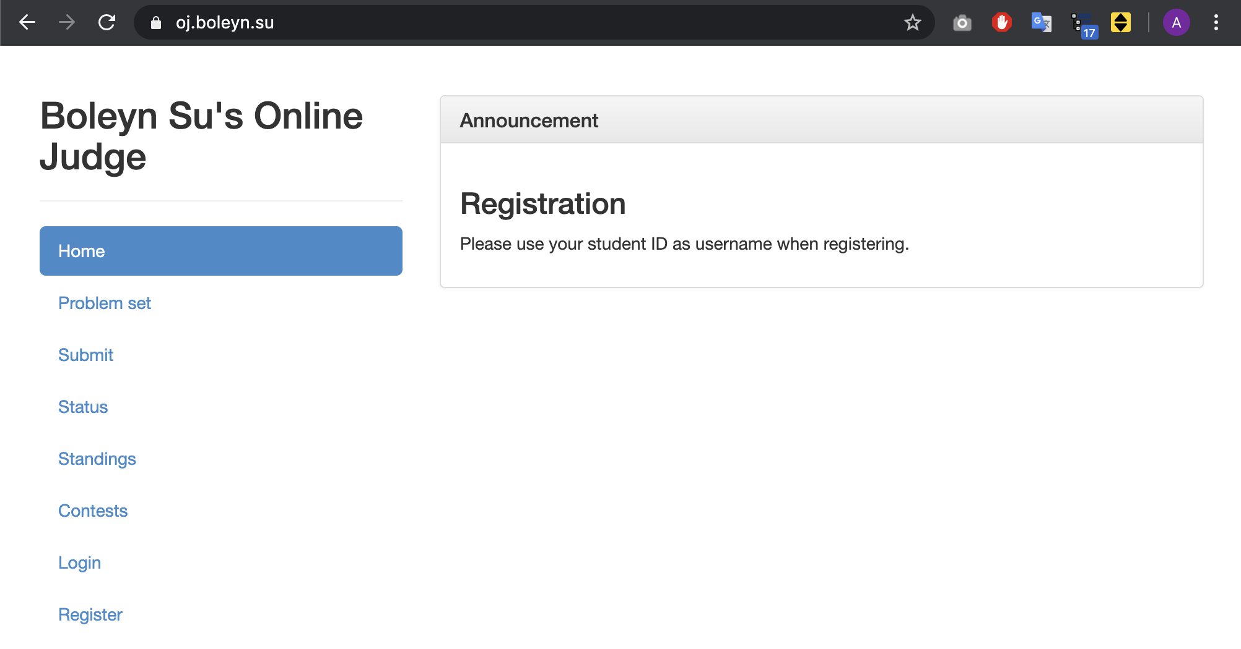
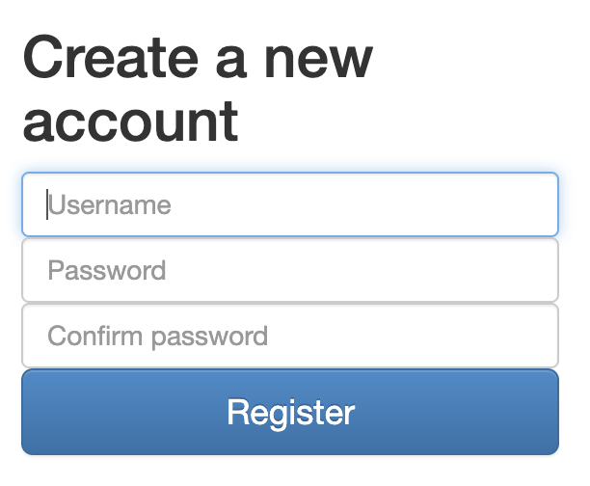

Online Judge Platform (OJ) Guide on Usage
1. Registration/Login
Click Register → Register → Click Login → Login
Your SID (e.g. 1155012345)
Please make sure you register correctly with your SID as grading of your score relies on your sid.

Slide 7
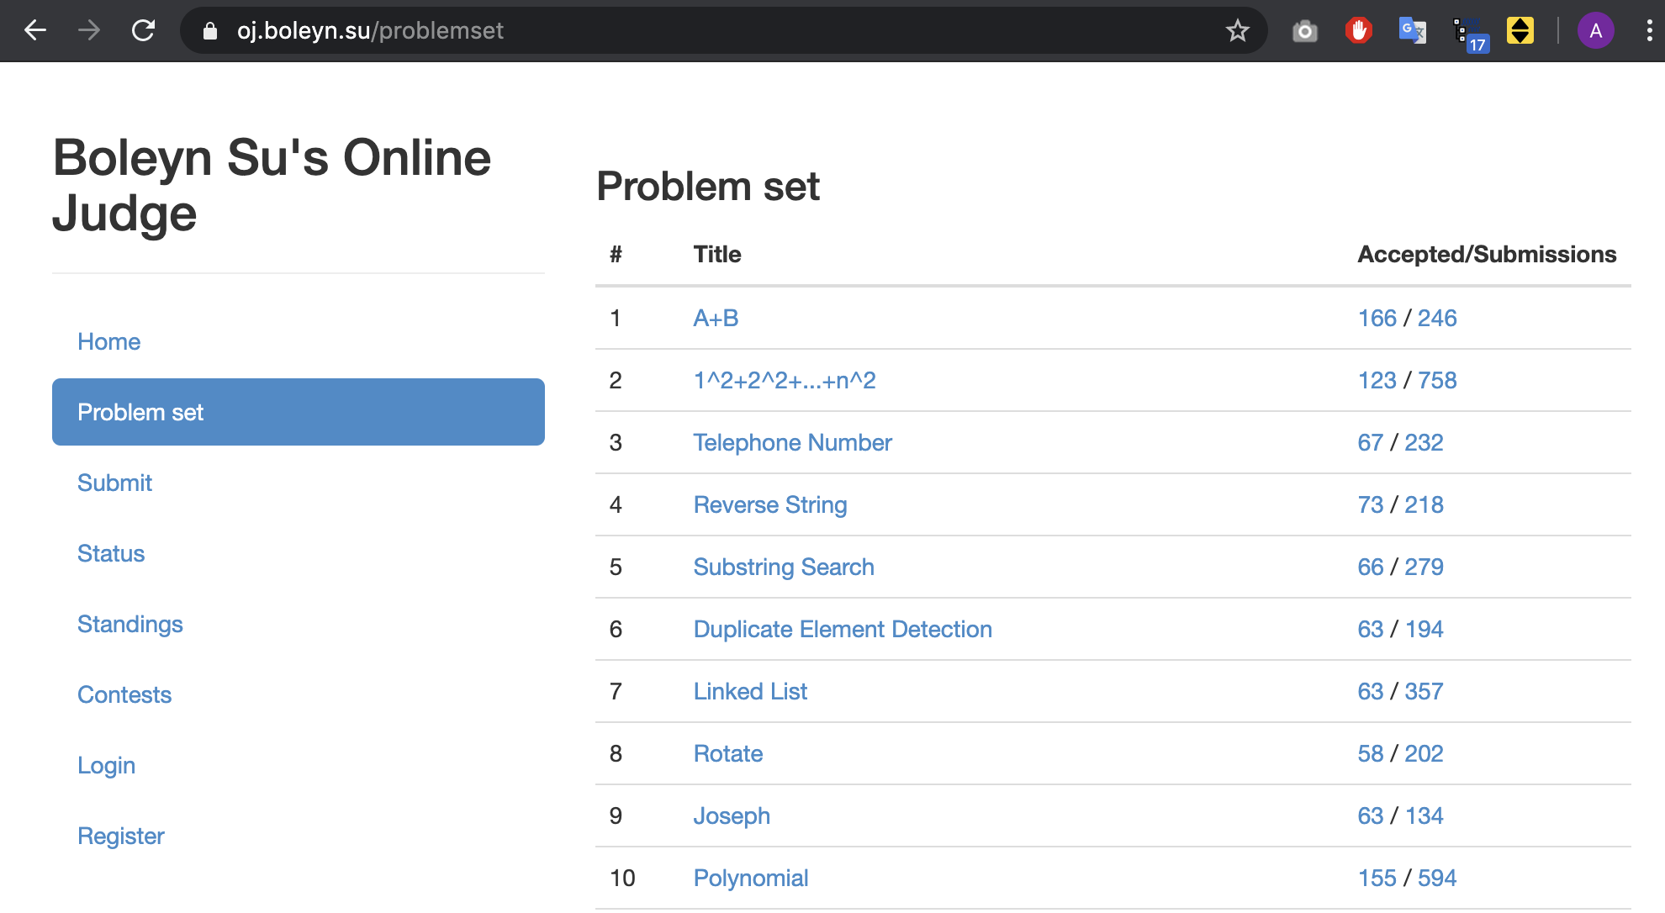
Online Judge Platform (OJ) Guide on Usage
2. Problem Set
List of problems you can try to solve!
Click Problem set
Click A+B

Slide 8
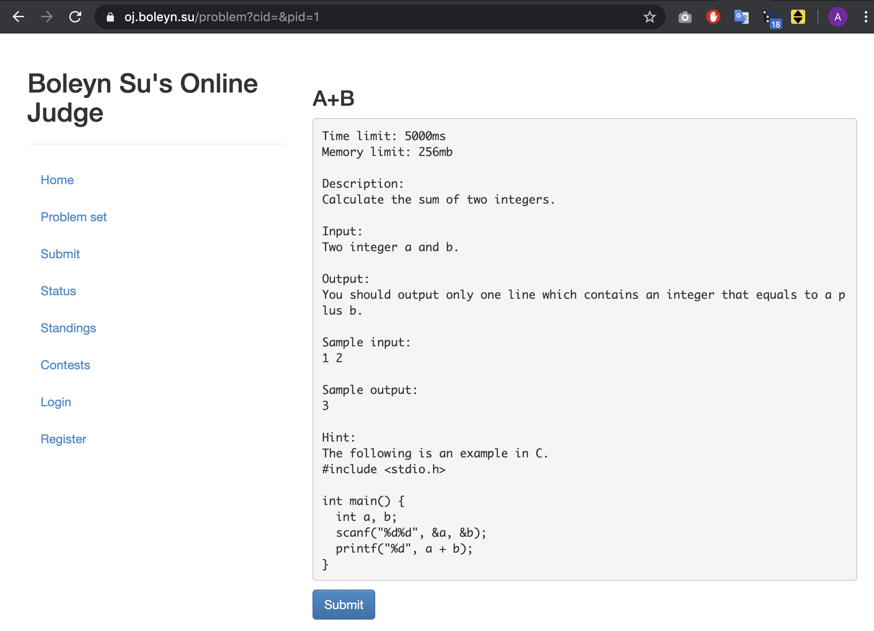
Online Judge Platform (OJ) Guide on Usage
3. Problem Description
Where the description, input/output specifications (with samples) of the problem are provided
Copy the demo code
Click Submit
Demo Code for Testing

Slide 9
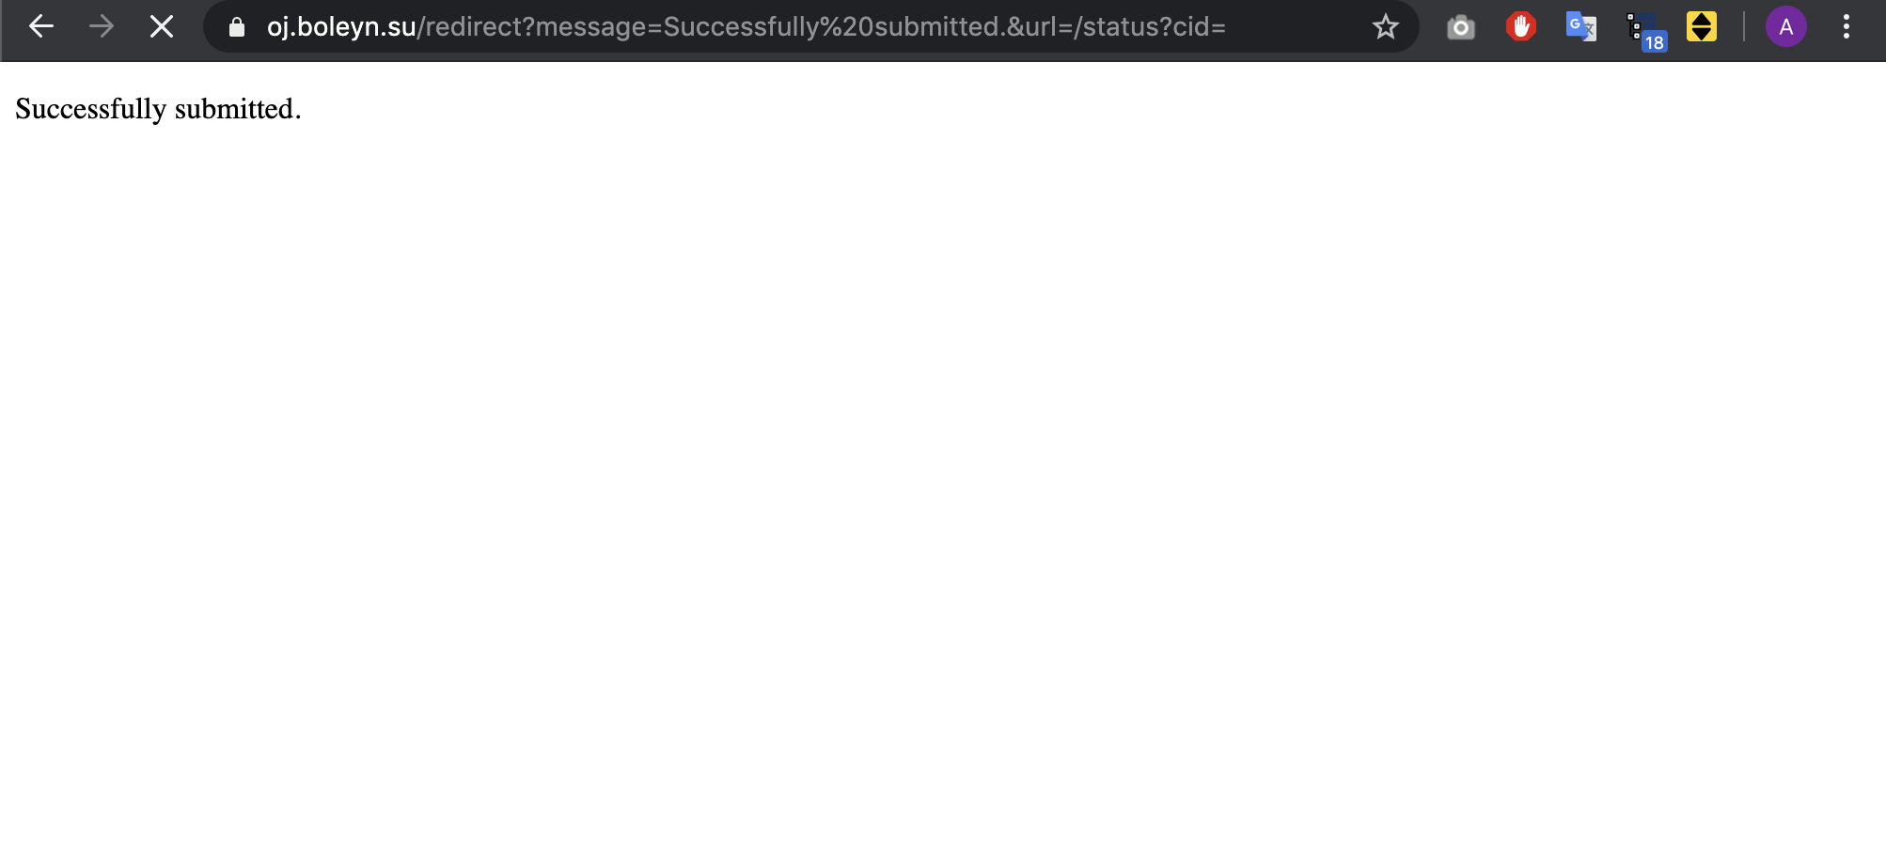
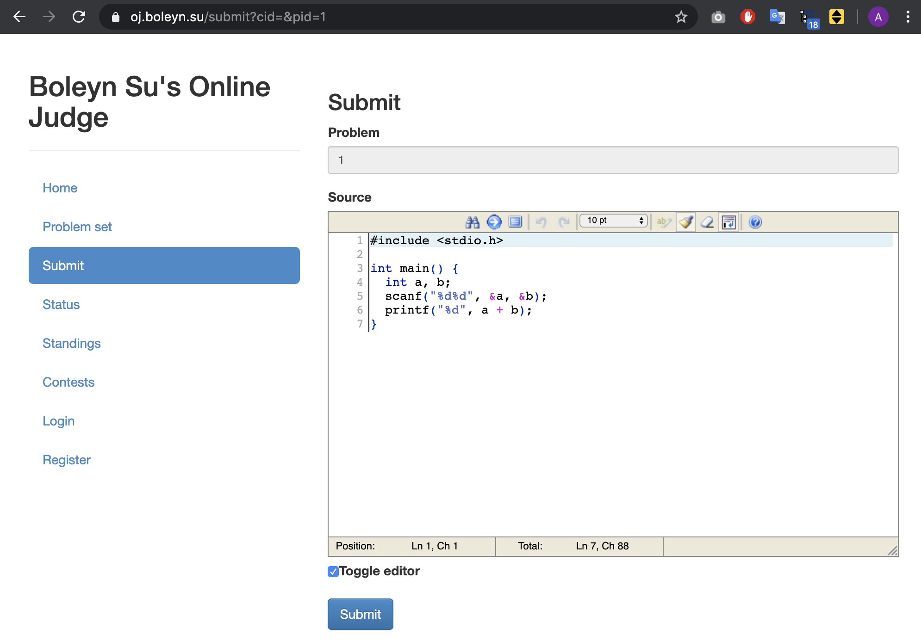
Online Judge Platform (OJ) Guide on Usage
4. Code Submission
Where you submit your code to the problem
Paste the demo code
Click Submit

Slide 10
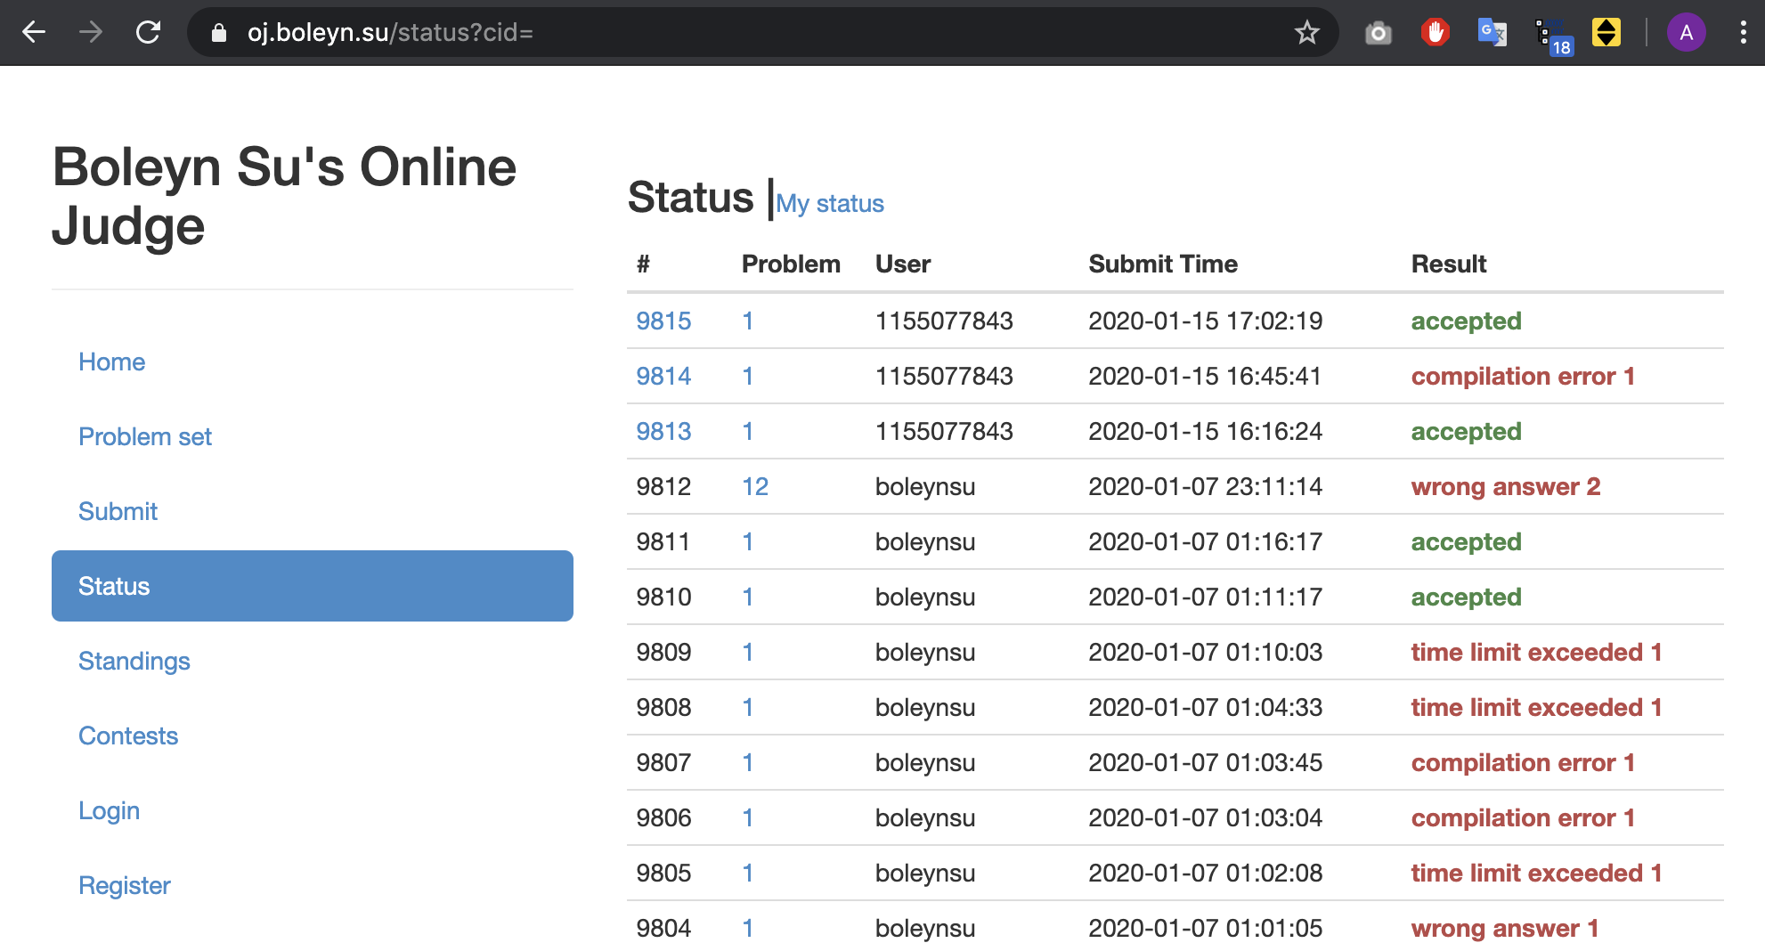
Online Judge Platform (OJ) Guide on Usage
5. Submission Status
Accepted:
It is all good: compiled successfully with correct answers on all testcases and executed within time limit
Wrong answer #n:
Outputs of the n-th testcase do not match the correct output
Time limit exceeded #n :
Your code runs too long for the n-th testcase. Normally the time limit is 5 seconds;
Compilation error #n :
Your code does not compile (e.g. syntax error)
Testing stops for the remaining testcases after the n-th one.

Slide 11
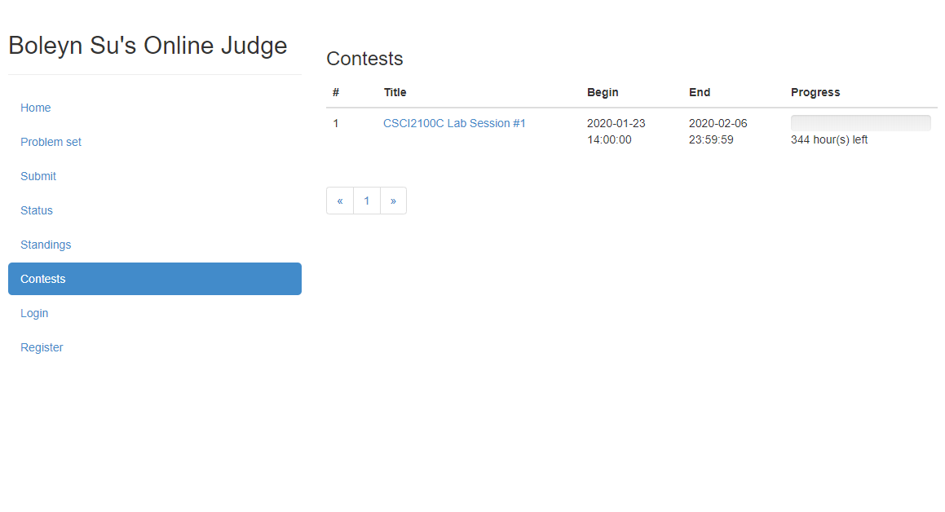
Online Judge Platform (OJ) Guide on Usage
6. Lab Assignments
Each lab assignment will appear at Contests upon release of it
After the deadline specified by End, no more submission will be accepted
Click into the title to submit your codes

Slide 12
Agenda
Online Judge Platform
Recommended IDEs
C language
Overview of Lab 1 Problems

Slide 13
Recommended IDE
Recommended:
Visual Studio Code (Windows/Mac)
https://code.visualstudio.com/
CodeBlock (Windows/Mac)
http://www.codeblocks.org/downloads/26
Dev C++ (Windows)
https://sourceforge.net/projects/orwelldevcpp/
Also Consider:
Online C IDE
Text editor + C compiler
IDE of your choice

Slide 14
C language Compilation Model
source code
Most frequently used and free available compiler:
GNU C compiler
Installation:
Refer to https://www.tutorialspoint.com/cprogramming/c_environment_setup.htm
Compile in terminal under the directory with your C source code, e.g.
$ gcc hello.c –o hello_program
$ ./hello_program
Hello, World!
preprocessor
compiler
(additional code)Libraries
object code
(machine instructions)
linker
executable code

Slide 15
Agenda
Online Judge Platform
Recommended IDEs
C language
Overview of Lab 1 Problems

Slide 16
C language Revisit
All programming labs must be completed with C only (not C++).
Assume basic knowledge of C
Syntax, data type, function, variable scoping, control flow, loop, pointer, array, struct, header file, …
Nice C tutorials can be found at:
https://www.learn-c.org/
https://www.tutorialspoint.com/cprogramming/index.htm
Google!
Revisit some of the basics here

Slide 17
C language Pointer
pointer_demo.c
#include <stdio.h>
int main () {
int var = 20; /* actual variable declaration */
int *ip; /* pointer variable declaration */
ip = &var; /* store address of var in pointer variable*/
printf("Address of var variable: %x\n", &var ); /* address stored in pointer variable */
printf("Address stored in ip variable: %x\n", ip ); /* access the value using the pointer */
printf("Value of *ip variable: %d\n", *ip ); return 0;
}
Output
Address of var variable: bffd8b3c
Address stored in ip variable: bffd8b3c
Value of *ip variable: 20

Slide 18
C language Struct(ure)
struct_demo.c
#include <stdio.h>
#include <string.h>
struct Books {
char title[50];
int book_id;
};
void printBookTitle( struct Books *book ) {
printf( "Book title : %s\n", book->title);
}
int main( ) {
struct Books Book1; /* Declare Book1 of type Book */
strcpy( Book1.title, "C Programming");
printBookTitle( &Book1 ); /* print Book1 info by passing address of Book1 */
return 0;
}
Output
Book title : C Programming

Slide 19
C language Header File
header.h
The C preprocessor scans the specified file as input before continuing with the rest of the current source file.
An example is shown on the right, where a main program called header_demo.c uses the header file header.h
char *test (void);
header_demo.c
int x;
#include "header.h"
int main (void) {
puts (test ());
}
Output of C preprocessor while compiling header_demo.c
For system header files
int x;
char *test (void);
int main (void) {
puts (test ());
}
#include <file>
For self-written header files
#include "file"

Slide 20
C language Abstract Data Type (ADT)
set.h
#include <stdio.h>
#include <stdlib.h>
struct Node {
int Element;
struct Node * Left;
struct Node * Right;
}
struct Node * init_set(int x);
struct Node * set_insert(struct Node * r, int x);
void set_delete(Struct Node * r, int x);
Extending from the primitive data type in C, e.g. int, char, float, …
Idea of ADT:
Implementation details are hidden
Able to use the ADT:
With the interface (commented usage)
Without knowing about the low-level logistics
An ADT may be implemented in different data structures
E.g. Stack may be implemented with linked list or array
set.c
#include "set.h"
struct Node * init_set(int x) {
/* Implementation here */
}
struct Node * set_insert(struct Node * r, int x) {
/* Implementation here */
}
void set_delete(Struct Node * r, int x) {
/* Implementation here */
}
main.c
#include <stdio.h>
#include "set.h"
int main (void) {
Node * u;
...

Slide 21
Agenda
Online Judge Platform
Recommended IDEs
C language
Overview of Lab 1 Problems

Slide 22
Lab 1 Problem 1
Binary Search
Description:
Given a list L of unique integers and a list T of target values, find out the indices of the target values in the list L (if exists), or report its absence.
Input:
First line contains a non-negative integer N;
The second line contains L, a sorted (in ascending order) list of N unique integers, L_0, L_1, ..., L_(N-1);
The third line contains T, a list of M target values, T_0, T_1, ..., T_(M-1), each separated by a space.
0 <= N,M <= 10^6
Output:
A line of M integers, I_0, I_1, ..., I_(M-1), where I_j = x if L_x = T_j, otherwise I_j = -1 if T_j is not in L.
Sample Input 1:
8
1 12 25 30 36 40 45 58
12 25 30 36 40 45 58 1 12
Sample Output 1:
1 2 3 4 5 6 7 8 0 1
Straight forward binary search
Key to note:
Uniqueness of n integers
Condition for -1
Use the provided code template
Complete the missing part and submit
Sample Input 2:
10
1 2 3 4 5 6 7 8 9 10
1 0 10
Sample Output 2:
0 -1 9

Slide 23
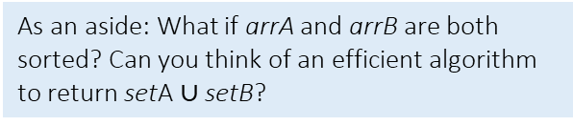
Lab 1 Problem 2
Set Union
Description:
Given two arrays of non-negative integers, denoted as arrA and arrB, the sets setA and setB are the unique elements of arrA and arrB respectively. Please complete the missing part of the following code to compute the union of setA and setB with the aid of the implemented ADT:
Input:
Four lines, where:
First line is a non-negative integer A;
Second line is arrA of A non-negative integers;
Third line is a non-negative integer B;
Fourth line is arrB of B non-negative integers;
0 <= A, B <= 10^3
Output:
You should output the union of setA and setB in ascending order.
Sample Input 1:
7
1 2 5 6 7 9 10
5
1 2 3 4 8
Familiarize with the use of ADT
Just apply the described function(s) and ignore the underlying implementation
Key to note:
Input may not necessarily be sorted
Choose the appropriate function(s) to apply
Description of function usage on OJ!
Use the provided code template
Complete the missing part and submit
The implemented ADT interface:
struct Node {
int Element;
struct Node * Left;
struct Node * Right;
}
struct Node * init_set(int x);
struct Node * set_insert(struct Node * r, int x);
void set_delete(struct Node * r, int x);
struct Node * preorder_merge(struct Node * r, struct Node * r_new);
struct Node * set_union(struct Node * a, struct Node * b);
void print_set(struct Node * r);
void arr_union(int a[], int b[], int size_a, int size_b);
Sample Output 1:
1 2 3 4 5 6 7 8 9 10
As an aside: What if arrA and arrB are both sorted? Can you think of an efficient algorithm to return setA $∪$ setB?

Slide 24
Last but not Least
Please add this declaration on top of (commented as shown) all your codes submitted to the OJ.
/*
I, <Your Full Name>, am submitting the assignment for
an individual project.
I declare that the assignment here submitted is original except for
source material explicitly acknowledged, the piece of work, or a part
of the piece of work has not been submitted for more than one purpose
(i.e. to satisfy the requirements in two different courses) without
declaration. I also acknowledge that I am aware of University policy
and regulations on honesty in academic work, and of the disciplinary
guidelines and procedures applicable to breaches of such policy and
regulations, as contained in the University website
http://www.cuhk.edu.hk/policy/academichonesty/.
It is also understood that assignments without a properly signed
declaration by the student concerned will not be graded by the
teacher(s).
*/

Slide 25
Question?

